Slide 1
How to Partner Pages
Guide for how the partner pages are set up

Slide 2
Process Info
Owner name | Annarose Peterson
Team | DnD
Resources | Docebo
Tools | HTML editing software, Photoshop
Description | Guide to the set up of the Customer Pages in AU
 | AU Member | AU Member | AU Member | AU Member | AU Member | AU Member | AU Member | AU Member | AU Member
Date

Slide 3
Overview
This is a guide on how each partner page was built along with the resources/codes used on the pages.
Partner Homepage product cards can be edited on the Partner Product Icons Large
All parts of the pages that use HTML, you can refer to How to edit an HTML widget on AU pages.pptx for instructions on how to edit
The homepage images all make use of CSS that point to the property “signal-nav”, if you are editing HTML widgets, make sure the images have the following tag is updated as follows: <div class="signal-nav"><a class="active" title="<<add Title>>" href="<<add URL link>>"><img style="display:block;margin-left:auto;margin-right:auto;" src="<<IMAGE URL>>" alt="<<Alternate text>>" width="XX" height="XX" /></a></div>
All images and files associated with Partner pages are located here: Partner Pages

Slide 4
Page General Settings
Instructions on how to build pages are found here: How to set up pages in AU.pptx
All General Settings for Customer pages are as follows:
Code: PAR-XXX
XXX is an abbreviation of the product or description of the page you are building.
For example, a customer page for Amplify would have the code “CUS-APIM”
Page Name: put full page name
Page Description: Add a description of what the page is used for
If it is a product page the description should read: “Partner <<product name>> Page”
Page icon:
All partner pages use this icon:
Additional Page options: All options should be turned off.

Slide 5
Menu Settings
Instructions on how to create or manage existing menus are here: How to manage menus in AU.pptx
Menu set up:
New menus for Partners is not necessary, as we have existing ones.
Follow these principles for menus to use when creating new pages or managing existing pages:
If the page must appear on the User menu for customers, add the page to the menu titled Partners (menu code: PAR-MENU)
If the page does not need to appear on the user menu, but partners should still have access and visibility to the page, add the page to the menu titled Menu to make extra parter pages visible (menu code: PAR-VIS)

Slide 6
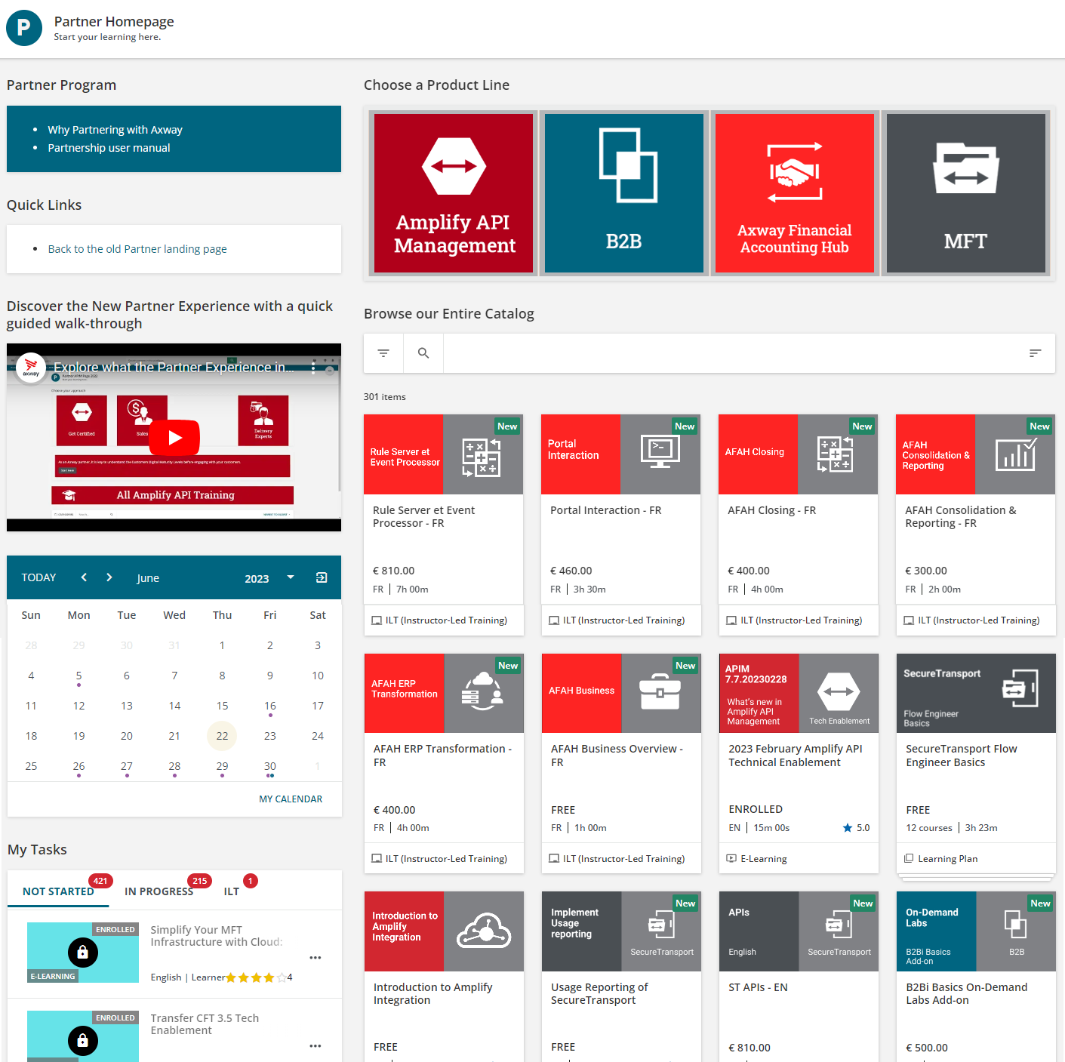
Homepage
HTML widget. Images for solutions are from Partner Product Icons Large.
HTML frame: homepage product icons framework.txt
HTML widgets.
Partner Program html
Quick Links html
Video of walk through for partner page hosted on Youtube.
Files for video found here: Homepage
Catalog widget. Set to display only the “Full Partner” catalog.
My Calendar widget
My Task widget.
Three tabs included on this widget are:
In progress
Not Started
ILT
All images and html frameworks found here: Homepage

Slide 7
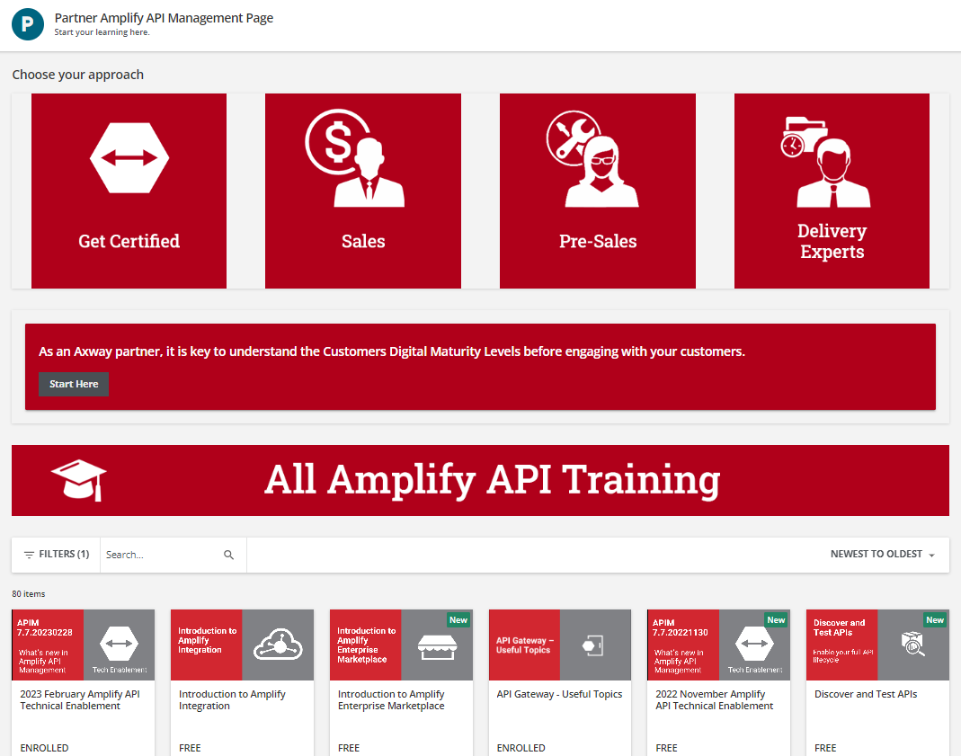
Amplify API Page
HTML Widget: APIM Page approach html.txt
Get certified: linked to partner catalog with filters Offer for Amplify and ILT.
Sales: Amplify Sales Learning plan
Pre-Sales:
Presales Enablement LP
Delivery Expert: Additional page.
All images and html frameworks found here: APIM
HTML Widget: Digital maturity widget.txt
Partner catalog filtered to APIM offer
Image widget: APIM Banner.png

Slide 8
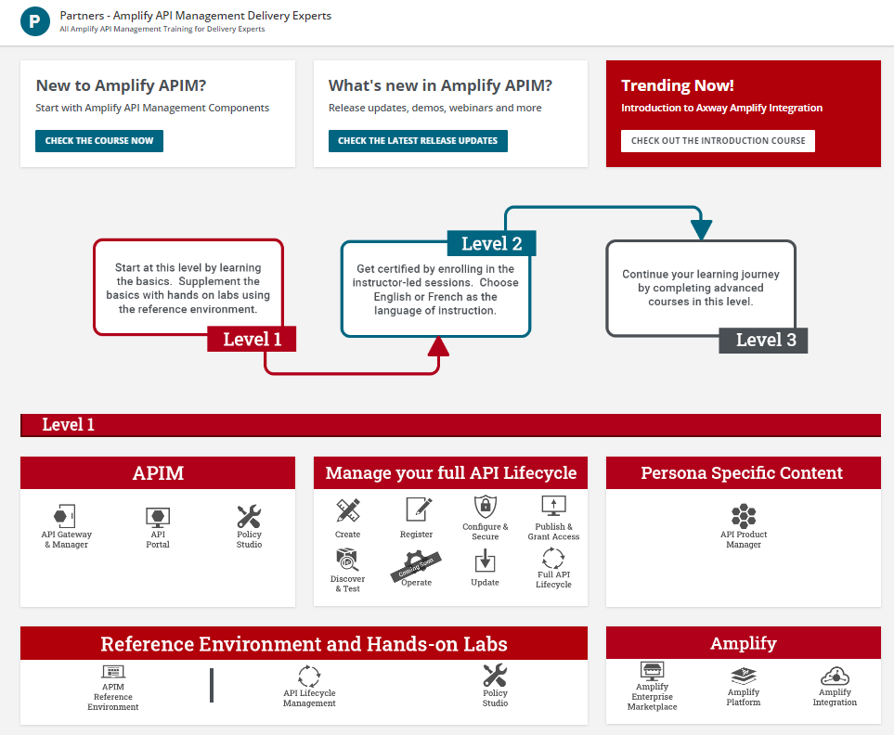
Amplify API Delivery Expert Page
Custom Content widget. Linked to the What’s new in Amplify Learning plan
Custom Content widget. Linked to the Amplify Integration Introduction course
All images and html frameworks found here: Delivery Expert
Custom Content widget. Linked to the API components course
Image widget: Level image full.png
Image widget: Level 1 11.3.22.png
html widget: APIM html widget one third.txt
html widget: persona specific content widget.txt
html widget: manage your full api lifecycle widget.txt
html widget: reference environment widget.txt
Reference Environment icon points to different page: https://university.axway.com/pages/71/partners-amplify-api-management-delivery-experts-reference-environment-information
html widget: ampify widget one third.txt
All images and html frameworks found here: Delivery

Slide 9
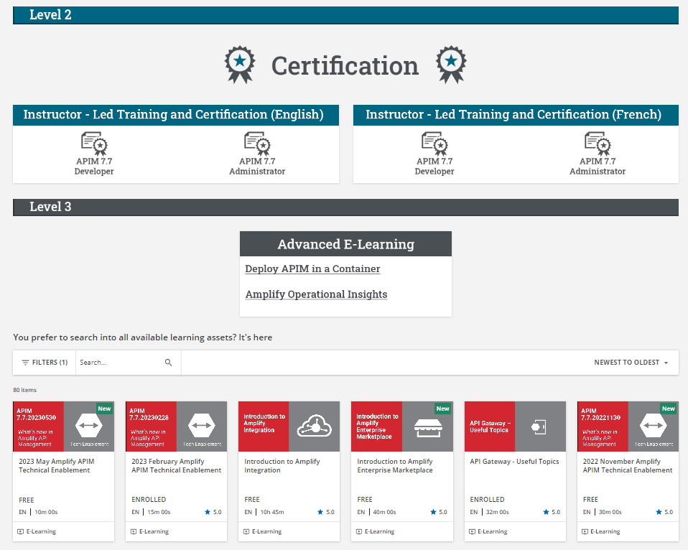
Amplify API Delivery Expert Page
Image widget: Certification label.png
All images and html frameworks found here: Delivery Expert
Image widget: level 2 label.png
html widget: ilt french widget half page.txt
html widget: ilt widget half page.txt
Image widget: Level 3 11.3.22.png
html widget: advanced elearning one third.txt
All images and html frameworks found here: Delivery
Partner catalog filtered to APIM offer

Slide 10
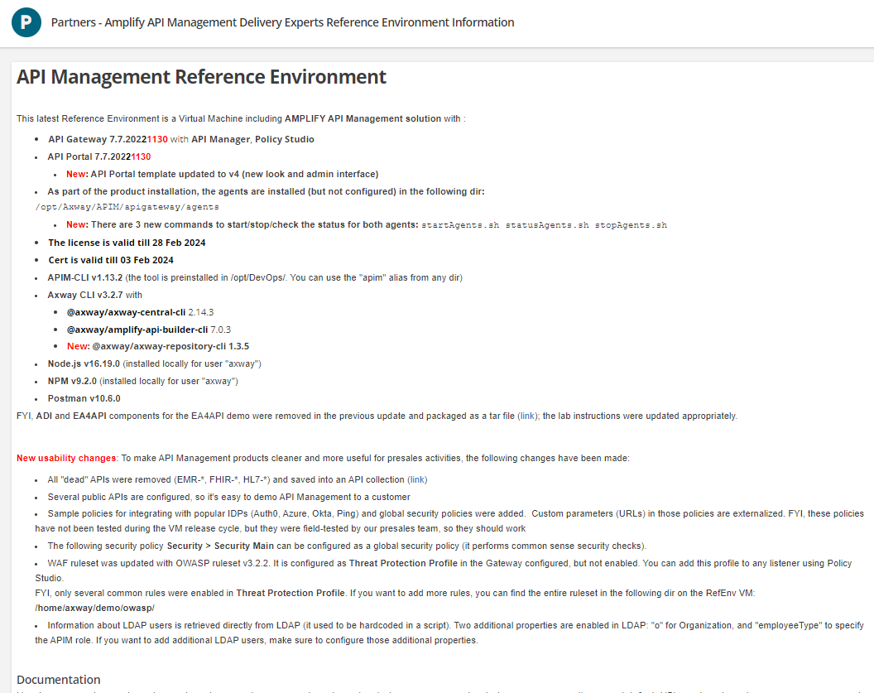
Amplify API Delivery Expert Reference Environment page
html widget: API reference envionment instructions html.txt

Slide 11
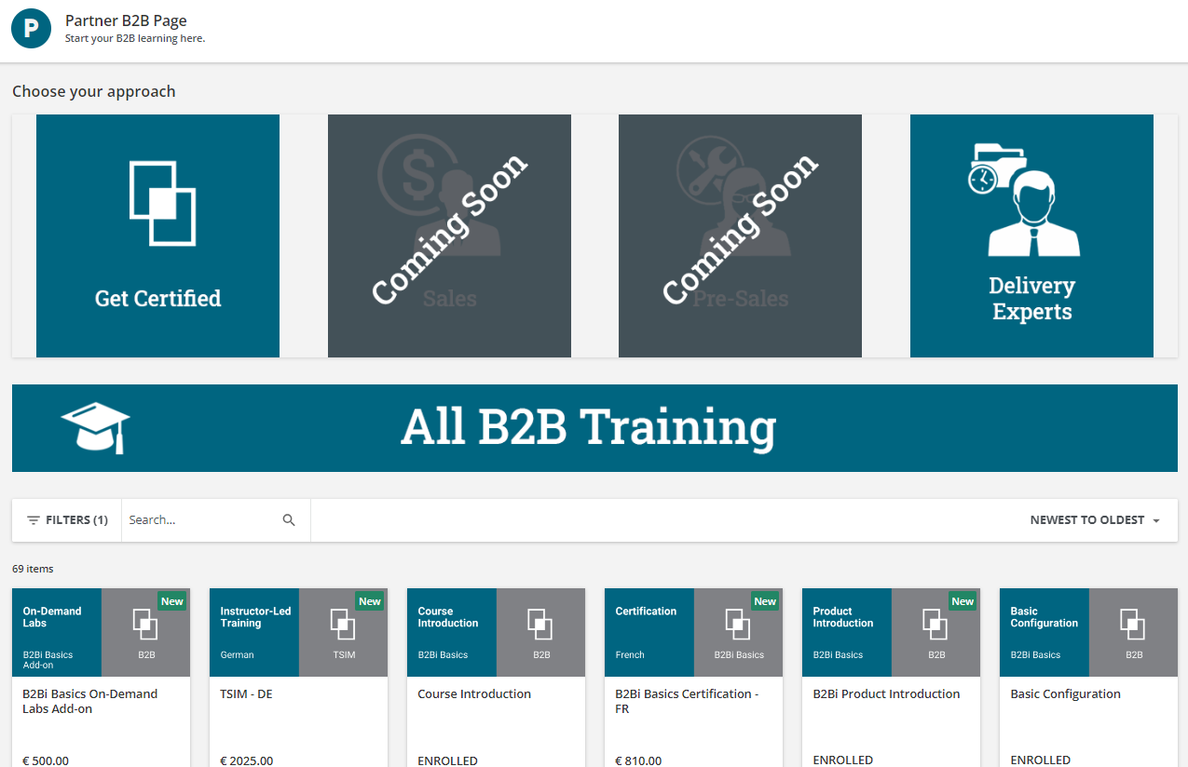
B2B page
HTML Widget: choose your approach html.txt
Get certified: linked to partner catalog with filters Offer for B2B and ILT.
Sales: NA
Pre-Sales: NA
Delivery Expert: B2Bi Basics Learning Plan
Partner catalog filtered to B2B offer
Image widget: b2b banner.png
All images and html frameworks found here: B2B

Slide 12
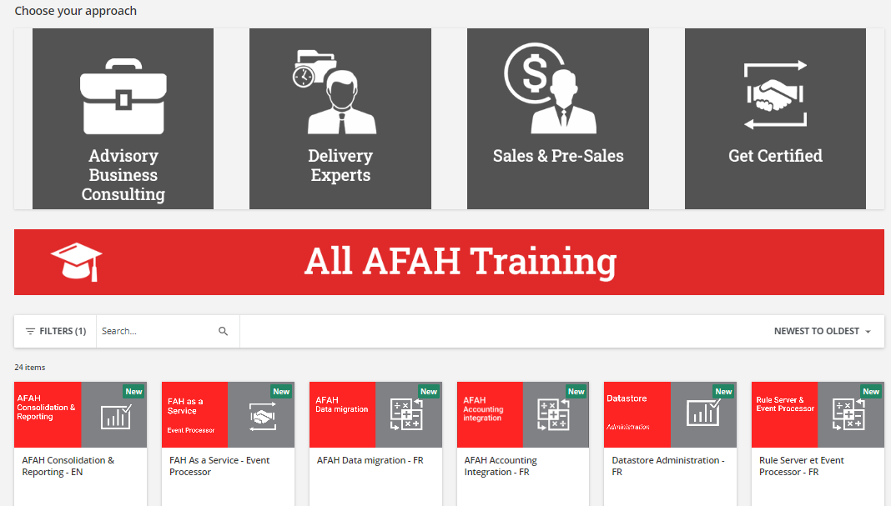
AFAH Page
HTML Widget: choose your approach widget.txt
Advisory Business Consulting: linked to the page https://university.axway.com/pages/87/partner-axway-financial-accounting-hub-advisory-business-consulting-training?ctl616=se-%22business%20overview%22
Sales & Pre-Sales: part catalog filtered to the sales and presales LP
Get Certified: full partner catalog filtered to AFAH offer and “Certification”
Image widget: afah banner.png
Partner catalog filtered to AFAH offer
All images and html frameworks found here: AFAH

Slide 13
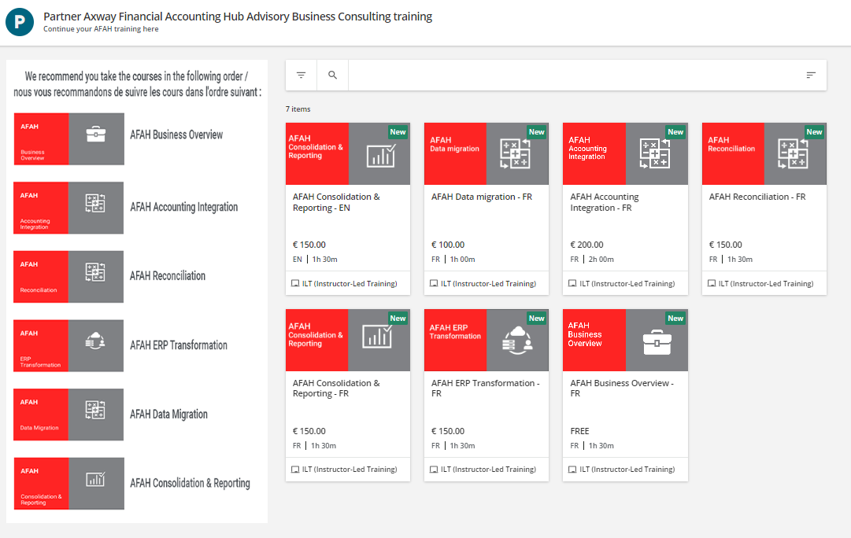
AFAH Advisory Business Consulting Page
Image widget: AFAH Business Consulting course list.png
Partner catalog filtered to AFAH offer and “business overview” text search

Slide 14
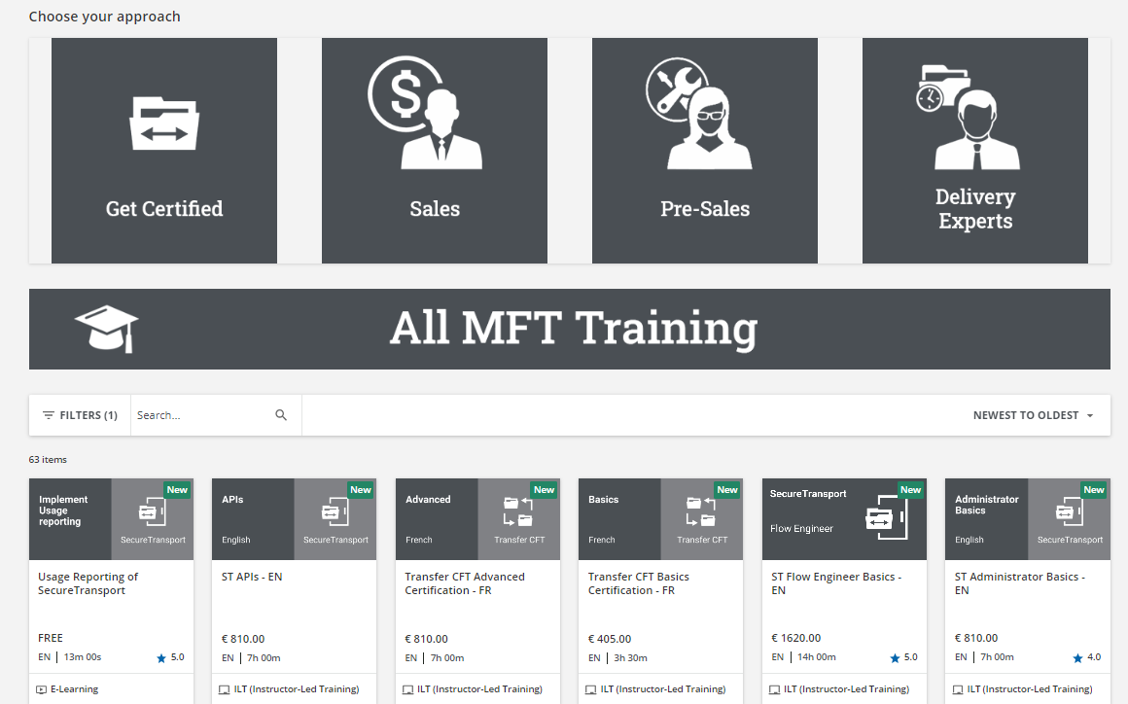
MFT Partner Page
HTML Widget: choose your approach.txt
Get certified: linked to partner catalog with filters Offer for MFT and ILT.
Sales: MFT Sales core LP
Pre-Sales: MFT Presales LP
Delivery Expert: Full partner catalog filtered to “Delivery Experts”
Image widget: mft banner.png
All images and html frameworks found here: MFT

